Slide 1
Exercise Template
WAKAMATSU Shunya
Japan Meteorological Agency

Slide 2
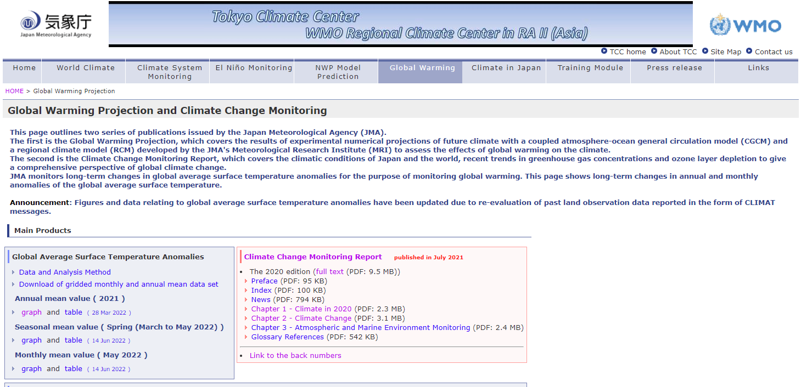
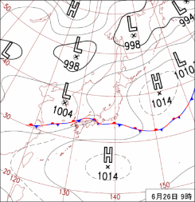
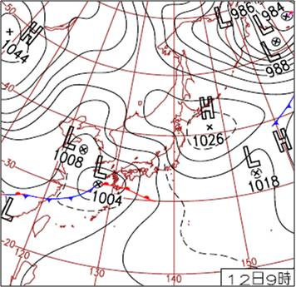
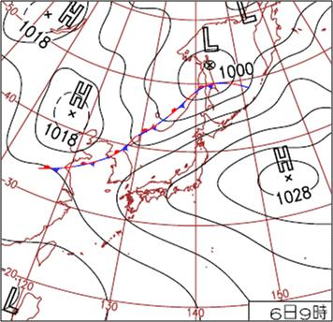
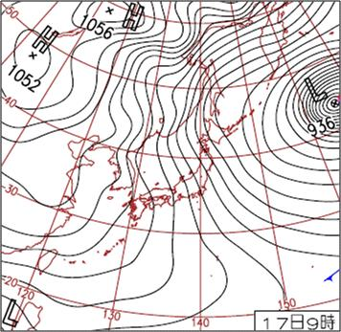
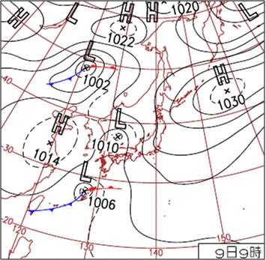
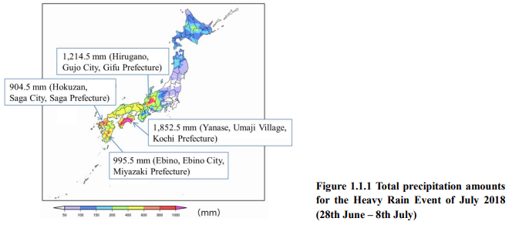
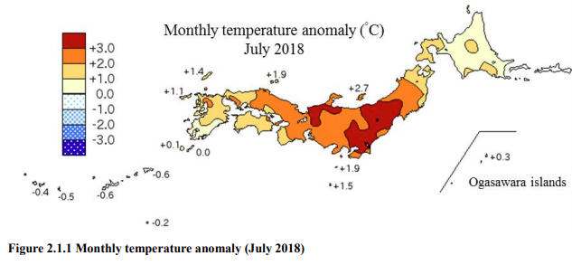
Template: Introduction
Sample
Tokyo Climate Center / Japan Meteorological Agency
JMA assess the effects of global warming on the climate with the Global Warming Projection with climate models developed by the JMA's Meteorological Research Institute (MRI).
JMA monitors long-term changes in global average surface temperature anomalies for the purpose of monitoring global warming.
Climatology in Japan
Early summer is the rainy season, known as the Baiu, caused by a stationary Baiu front.
In Summer, the North Pacific High extends northwestward around Japan, bringing hot and sunny conditions.
Monthly precipitation amounts are large in autumn due to the active autumnal rain front and tropical cyclones.
Recent extreme events
The Heavy Rain Event of July 2018 from western Japan to the Tokai region and the Subsequent Heatwave from Mid-July Onward
Record-heavy rain In mid-August 2021 from western to eastern Japan
Record-heavy rain and record low sunshine durations from eastern to northeastern Japan
Japan’s four seasons

Slide 3
Template: Observed Trend
Sample
The annual mean surface temperature in Tokyo has risen at a rate of 2.56ºC per century (statistically significant at a confidence level of 99%).
There has been no discernible trend in the annual mean precipitation in Tokyo.
(ºC)
Annual Mean Temperature (2.6 ºC/100yr)
(mm)
Annual Total Precipitation (no trend)
Years
Years

Slide 4
Template: Future Change
Sample
The projected changes in monthly mean surface temperatures in Tokyo in 2080-2099 relative to the 1995-2014 are in the range of +3.5ºC (Dec.) to +5.0ºC (Sep.). In August, the future value is 31.2ºC (Aug.).
The projected changes in total precipitation in Tokyo in 2080-2099 relative to the 1995-2014 have no significant tendency.
(ºC)
Monthly Mean Temperature Changes
(mm)
Monthly Total Precipitation Changes
Months
Months

Slide 5
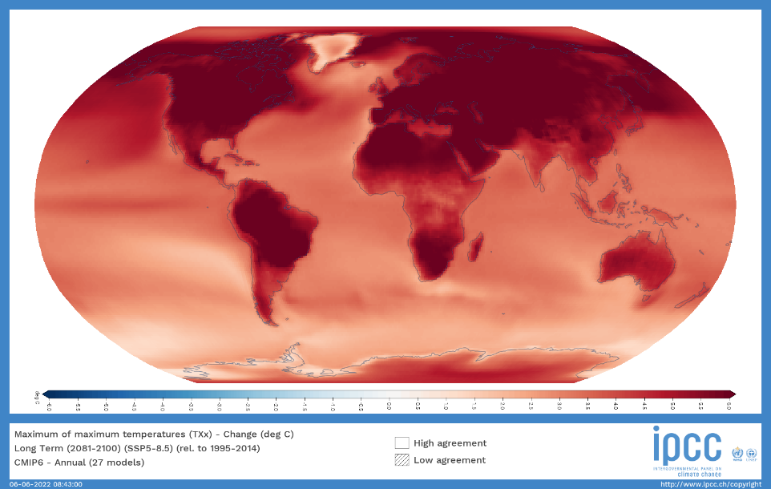
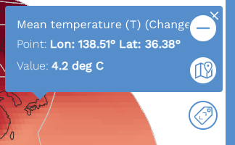
Template: Uncertainty (Reliability)
Sample
Under RCP8.5/SSP5-8.5, it is likely that most land areas will experience further warming of at least 4ºC compared to a 1995–2014 baseline by the end of the 21st century, and in some areas significantly more. <AR6 WG1 TS.4.3.1>
Considering emission scenario difference and the country location in the IPCC projection map, the projection with MRI-AGCM is similar with those in IPCC.
SSP8-8.5
Monthly Mean Temperature Changes
Multi-model’s annual projected change
The change from 1995 – 2014 to 2081 – 2100 in annual hottest daily maximum temperature, TXx. <AR6 WG1 Interactive Atlas>
https://interactive-atlas.ipcc.ch/

Slide 6
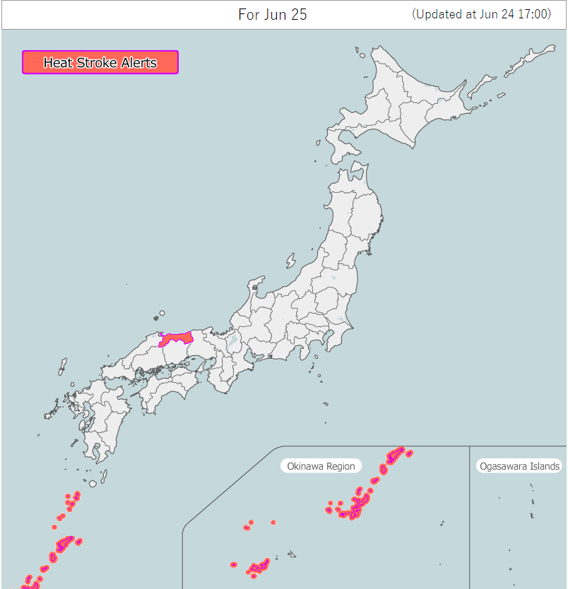
Template: Summary and Discussion
Sample
Findings
The annual mean surface temperature in Tokyo has risen at a rate of 2.56ºC per century.
In August, the projected value in surface temperatures in Tokyo in 2080-2099 relative to the 1995-2014 is 31.2ºC.
Estimated impact on the society
Risk of heat stroke would be increased.
Actions to be needed I think
Increasing people’s awareness about "Heat Stroke Alert"
https://www.wbgt.env.go.jp/en/#alert_map

